Slide 1




SMART
PET FEEDER
welcome
Presented by Pp

Slide 2

Pp
Maneerat Sangkaosud 2411311778
Sainam Luo 2411311786
Teekatas Borinayok 2211310020

Slide 3


Project Overview
Smart Pet Feeder is an automatic pet feeding system developed using ESP32. The system can dispense pet food automatically every 10 seconds. Users can also feed their pets manually using a push button.
The system can check the food level and alert the user when the food is low or empty. It can also detect the pet, count the number of times food is dispensed, and count how many times the pet comes to eat after the system starts.
Users can also adjust the food amount to 3 levels: Low, Medium, and High. The system displays food information and system status on an OLED screen, while LEDs show the current system status.

Slide 4

Project Detail
Automatic Feeding
Pet Eating Detection
  Dispence food automatically according to the scheduled feeding time.
  Detect when the pet comes to feeding area.
  Count an eating time only when the pet stays in the area for 3 seconds.
  The system counts again only after the pet leaves and return.
Manual Feeding
  Allow the user to despense food manually using a push buttom.
Status Display
Food Amount Selection
  Display food level, feeding amount, feeding count, and system status on the OLED
  Allow the user to select the amount of food : Low, Medium or High.
Status Indiccators
Food Level Monitoring
  Use LED to indicate พeady, Feeding and Food Empty status.
  Monitor the amount of food remaining in the container
  Alert the user when the food level is
low or empty

Slide 5



Project Specification
Controller
System Parameters
  ESP32
  Food Amount : Low, Medium, High
  Feeding Time : every 10 seconds
  Pet detection Time : 3 seconds
  food Level : 100 % → 0 %
  Communication : I2C for OLED
Input Devices
  Push Button
  Potentiometer
  HC-SR04
Output Devices
  Servo Motor
  OLED
  LED

Slide 6
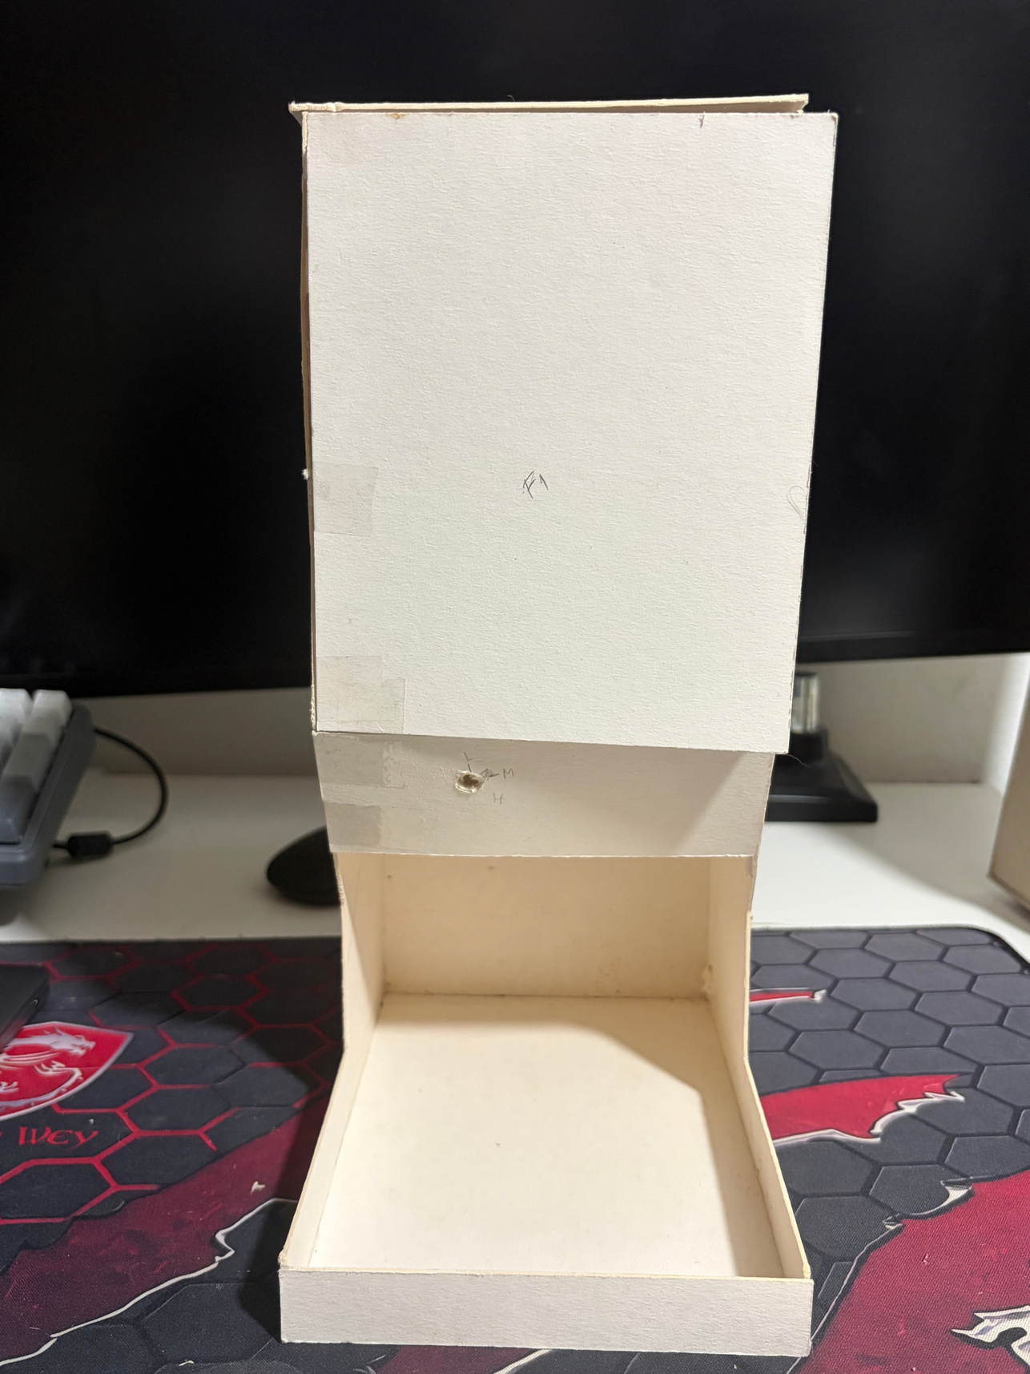
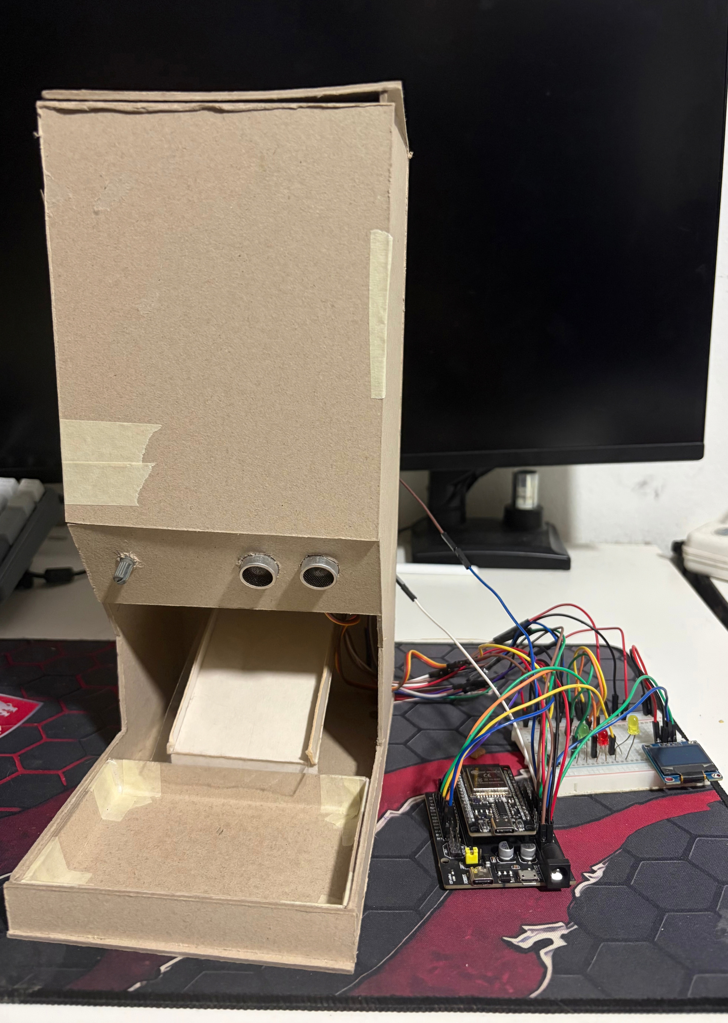
Project Plan
Intitial Plan
Actual
  2 LED : Operating / Not Operating
  No pet detection sensor
  3 LED : Ready, Feeding, Food Empty
  Added pet detection sensor

Slide 7

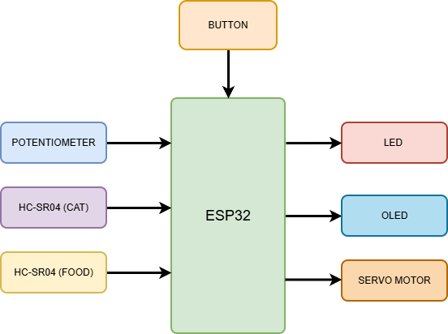




Architectural design

Slide 8

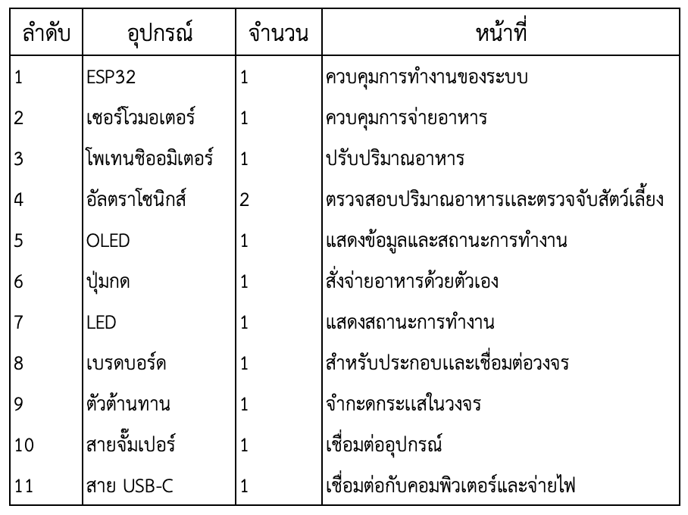

Hardware Selection

Slide 9
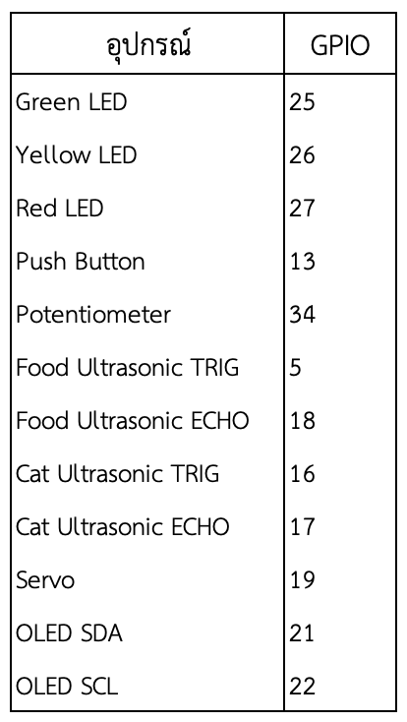
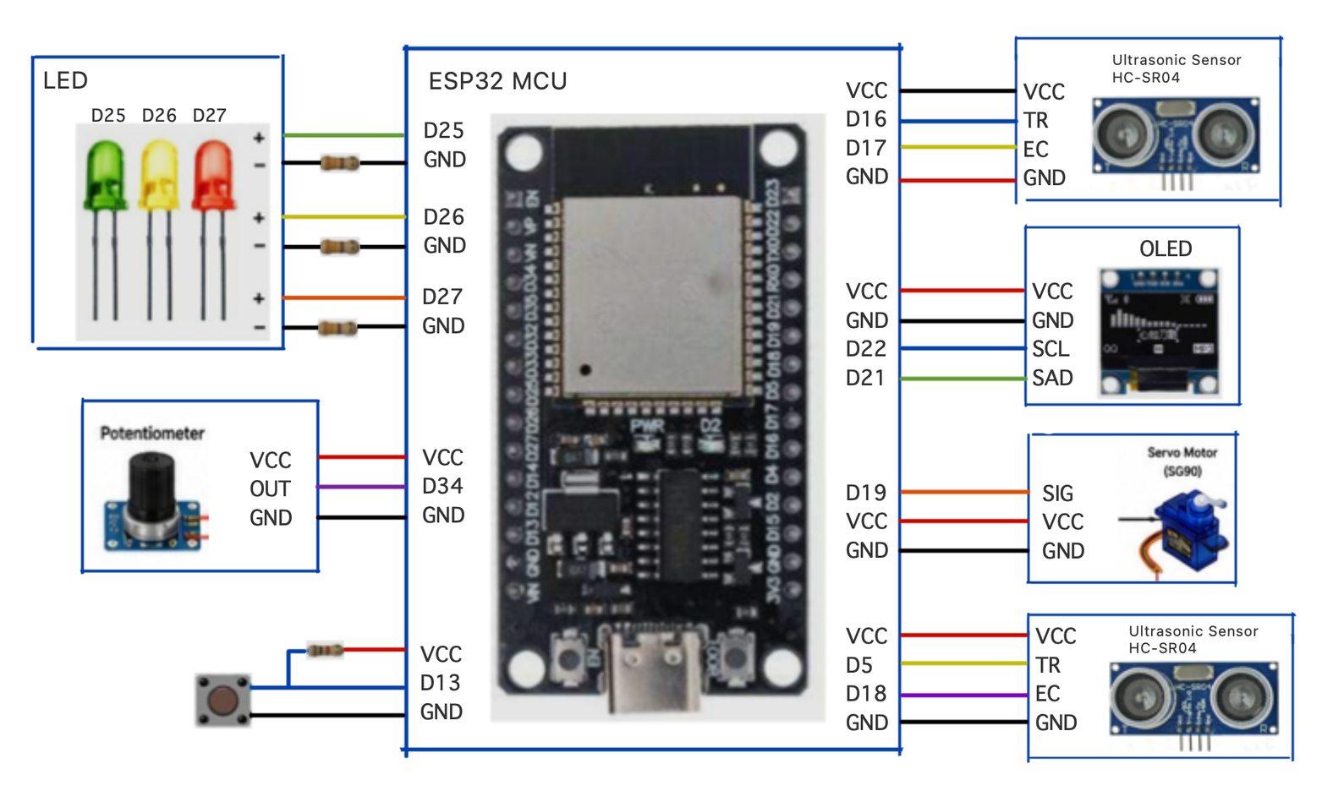

Detail Design

Slide 10
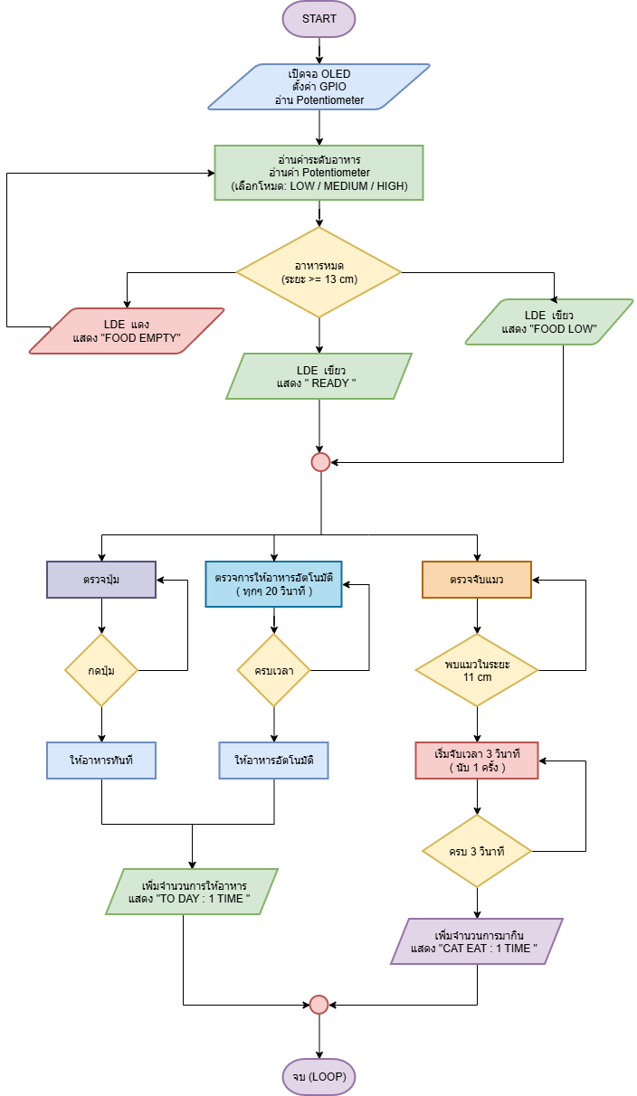
Flowchart

Slide 11
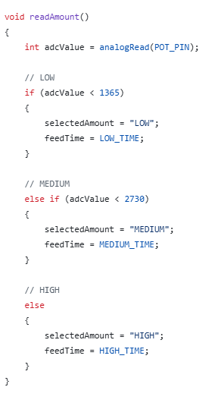
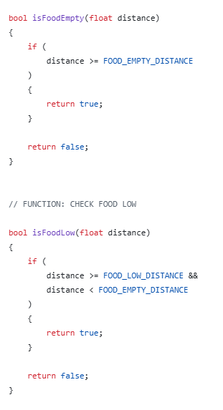
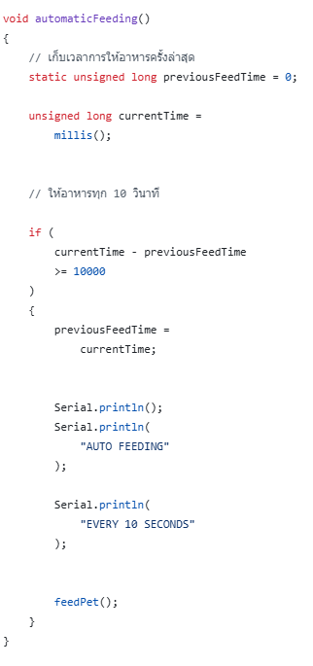
Code
3 Levels Food Amount
Food Level Measurement
Automatic feeding system every 10 seconds

Slide 12
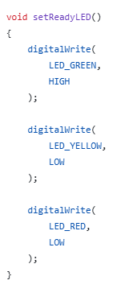
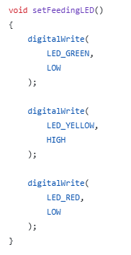
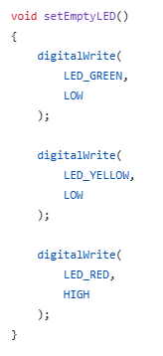
ReadyLED
FeedingLED
EmptyLED

Slide 13
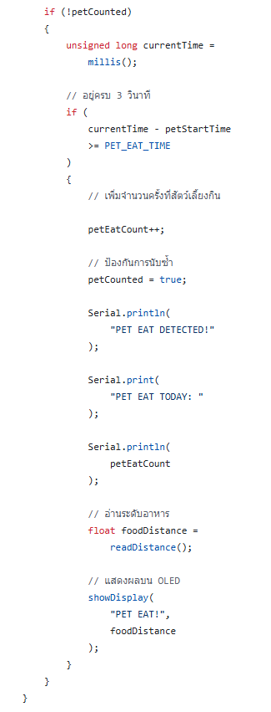
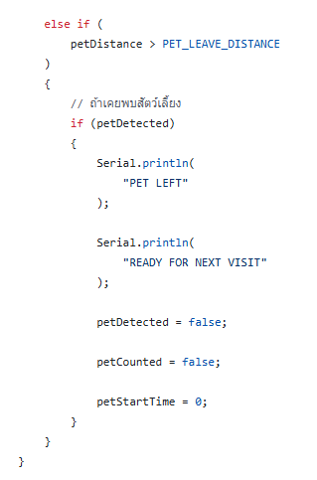
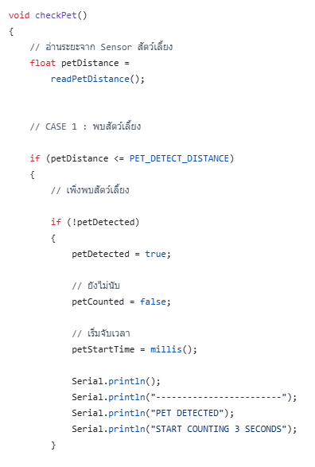
Pet Detection System

Slide 14
Testing and Results
Testing
Results
  Automatic food dispensing test
  Manual feeding using the push button
  Food amount adjustment test (3 levels)
  Food level detection test
  Pet detection test
  OLED and LED status display test
  Food was dispensed successfully.
  Food was dispensed manually using the push button.
  Food amount was adjusted successfully to 3 levels.
  Food level was detected successfully.
  Pet was detected successfully.
  OLED and LED displayed system status

Slide 15

Final
The Smart Pet Feeder can automatically dispense food, adjust the food amount, monitor the food level, detect pets, and display the system status through the OLED and LED indicators.

Slide 16
Link to VDO
Secure toxic substances, cords, plants, and small objects; use gates, ID tags, microchips, leashes, and constant supervision outdoors.

Slide 17
Problems and solutions
  Ultrasonic Sensor
Problem : The ultrasonic sensor detected the food container instead of the food when placed on the side.
Solution : Moved the ultrasonic sensor to the top of the smart pet feeder so that it could check the food level directly.
  Servo Motor
Problem : The servo motor worked normally at first, but later it sometimes worked and sometimes did not.
Solution : Changed the circuit and changed the way the food opening was opened and closed.
  Food Dispensing
Problem : Food got stuck in the dispensing opening, so it could not flow out continuously.
Solution : Widened the dispensing opening to allow the food to flow more smoothly.

Slide 18
Thank you

